Slide 1


Final project: Energy Efficiency
Course: CSCI E-63: Big Data Analytics _ Fall 2017
Presented by: Huynh Vo

Slide 2
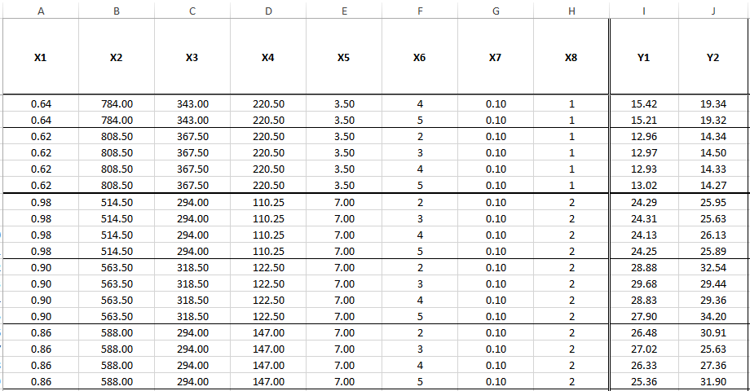

Data source: http://archive.ics.uci.edu/ml/datasets/energy+efficiency#

Slide 3
Information about dataset:
Attributions:
X1 Relative Compactness – No Unit
X2 Surface Area - m²
X3 Wall Area - m²
X4 Roof Area - m²
X5 Overall Height - m
X6 Orientation - 2:North, 3:East, 4:South, 5:West
X7 Glazing Area - 0%, 10%, 25%, 40% (of floor area)
X8 Glazing Area Distribution (Variance) - 1:Uniform, 2:North, 3:East, 4:South, 5:West
Y1 Heating Load - kWh/m²
Y2 Cooling Load - kWh/m²

Slide 4
Background and purposes of using this dataset:
The dataset relates how the size, shape, and other features of a building can help or hurt the energy required to keep the internal temperature of a building, such as a home, at a desired temperature.
Try to measure the transparency of the building
Use eight features to predict each of the two responses (Heating Load and Cooling Load) → Show the models evaluation

Slide 5
Tools used to explore this data:
Rstudio platform
Azure ML
R functions: Ggplot, Hmisc, histogram, boxplot, influency plot, correlation

Slide 6
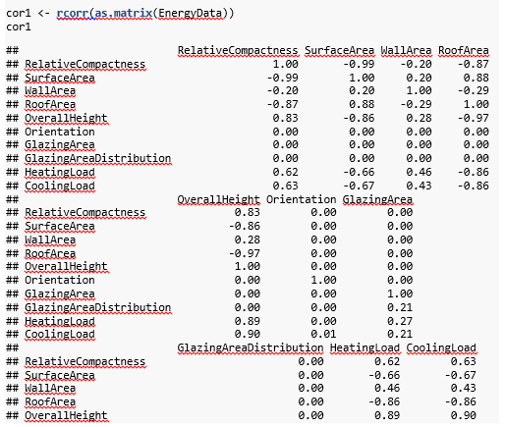
Data exploration _ Correlation

Slide 7
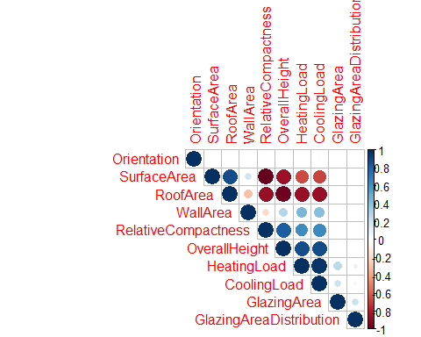
Data exploration _ Correlation

Slide 8
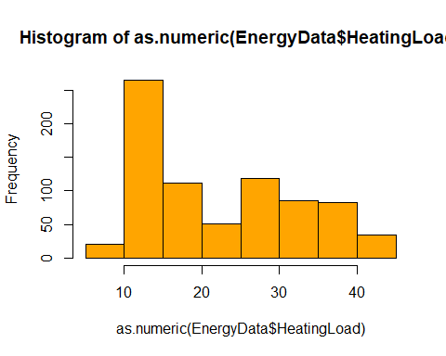
Exploring data:

Slide 9
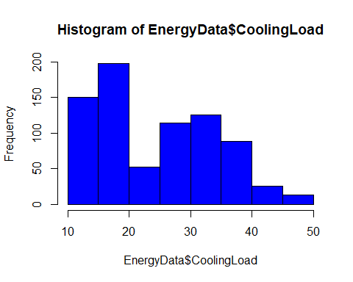
Exploring data:

Slide 10
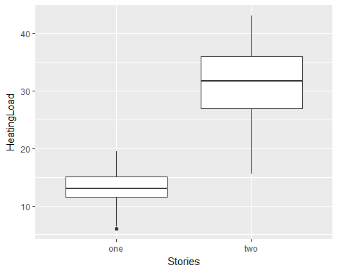
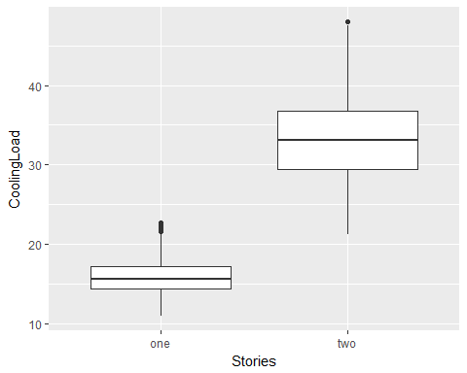
Exploring data: Building stories vs. Heating load and Cooling load

Slide 11
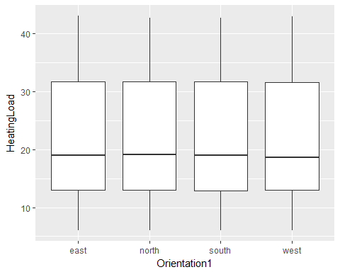
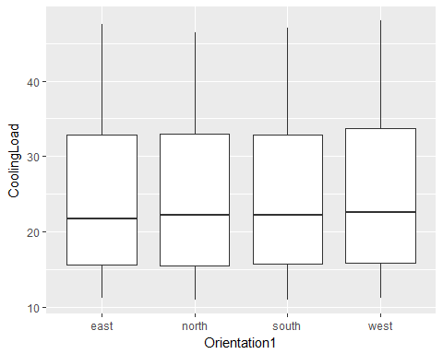
Exploring data: Orientation vs. Heating load and Cooling load

Slide 12
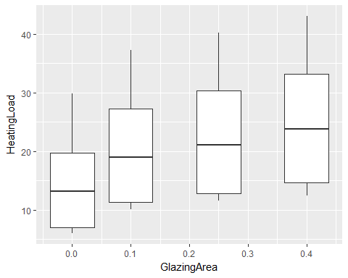
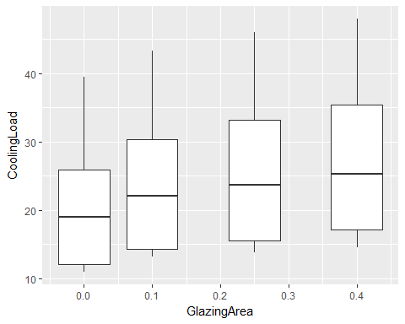
Exploring data: Glazing area vs. Heating load and Cooling load

Slide 13
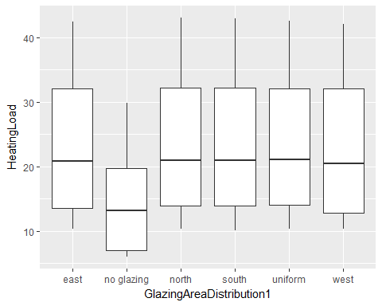
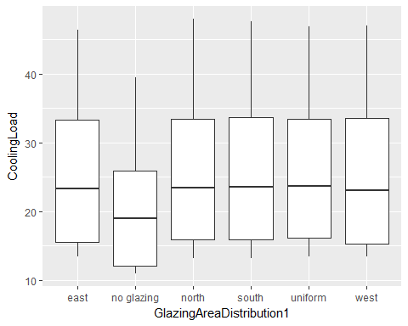
Exploring data: Glazing area distribution vs. Heating load and Cooling load

Slide 14
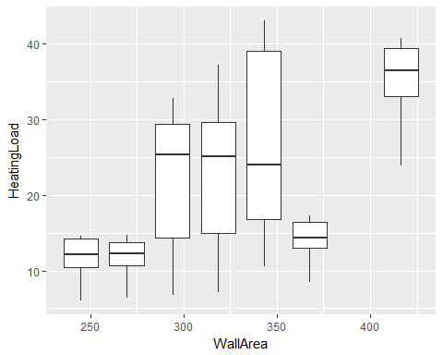
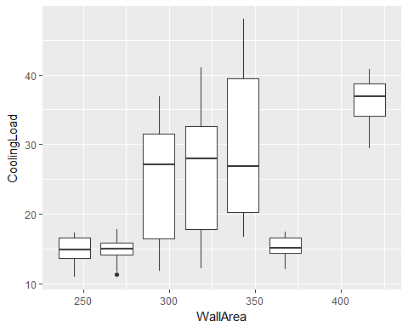
Exploring data: Wall area vs. Heating load and Cooling load

Slide 15
Azure ML
Model 1:
Neural Network Regression to predict HeatingLoad response
Model 2:
Boosted Decision Tree Regression to predict CoolingLoad response

Slide 16
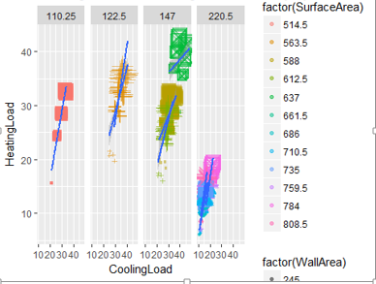
'HeatingLoad and CoolingLoad efficiency by Roof Area, Wall Area, Surface Area and Glazing Area'

Slide 17
How to choose model?
Targets:
Accurate
Interpretable
Fast
Scalable
For more information, please visit https://azure.microsoft.com/en-us/services/machine-learning-studio/

Slide 18
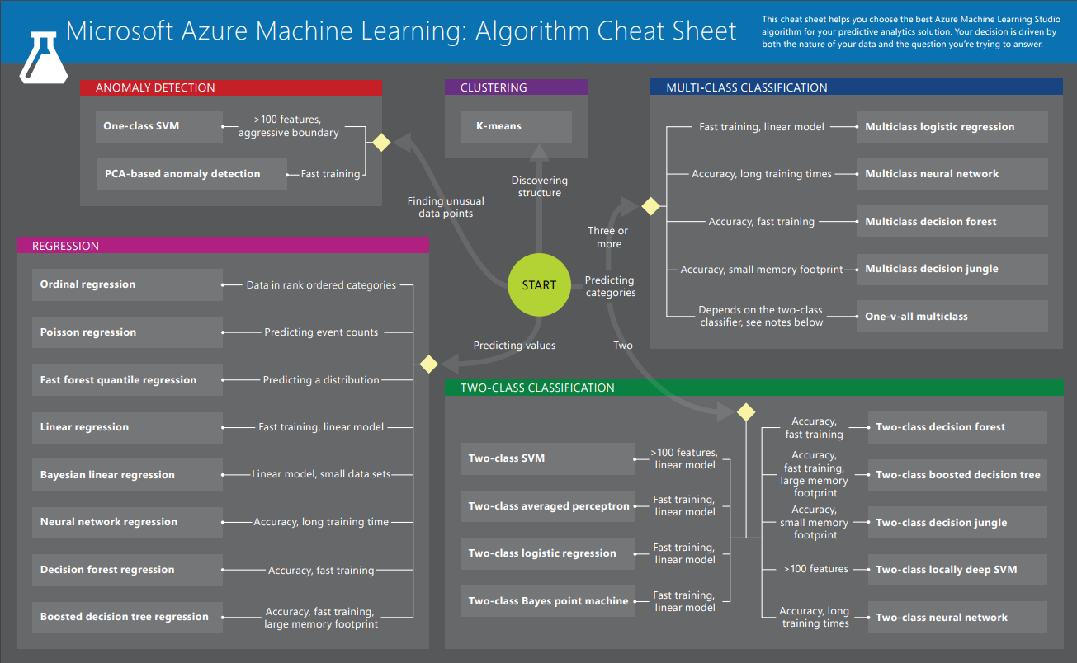

Slide 19
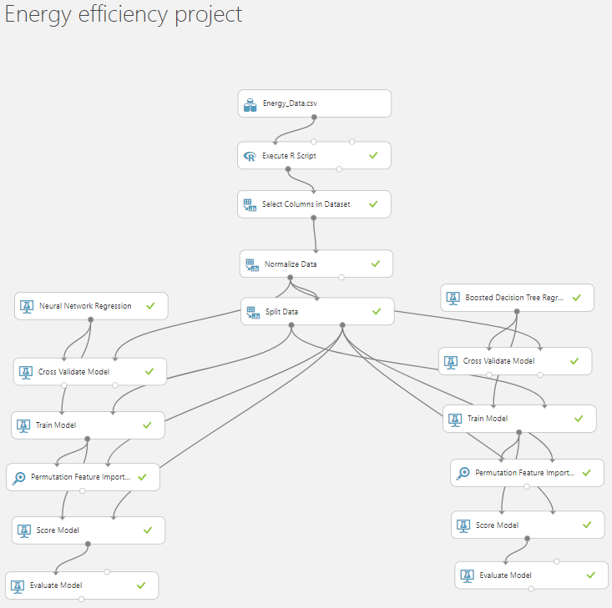

Slide 20
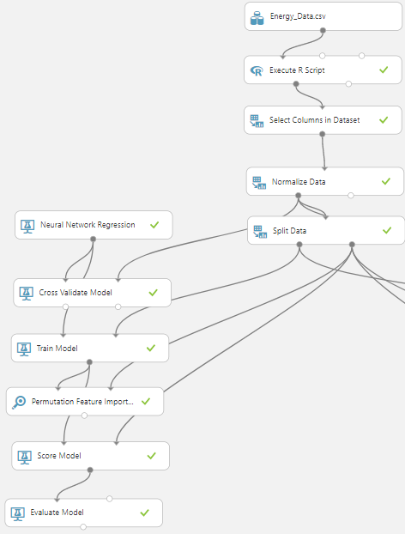
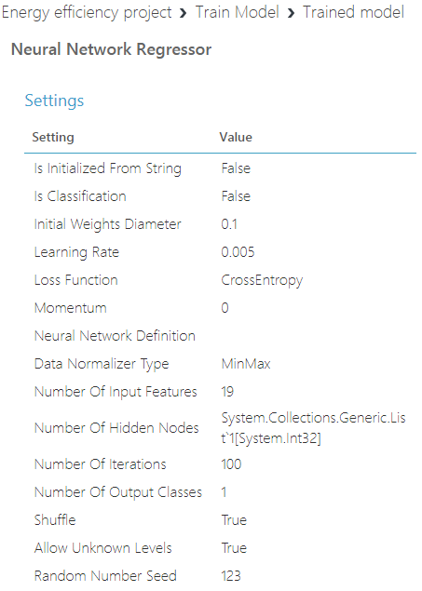

Slide 21
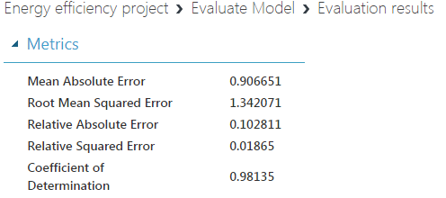
Neural Network Regression to predict HeatingLoad response

Slide 22
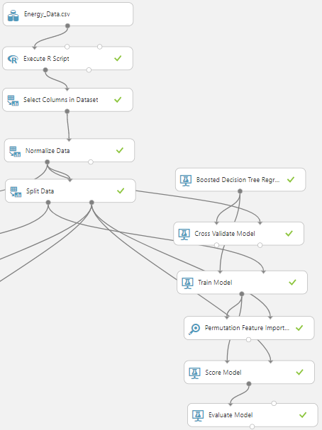
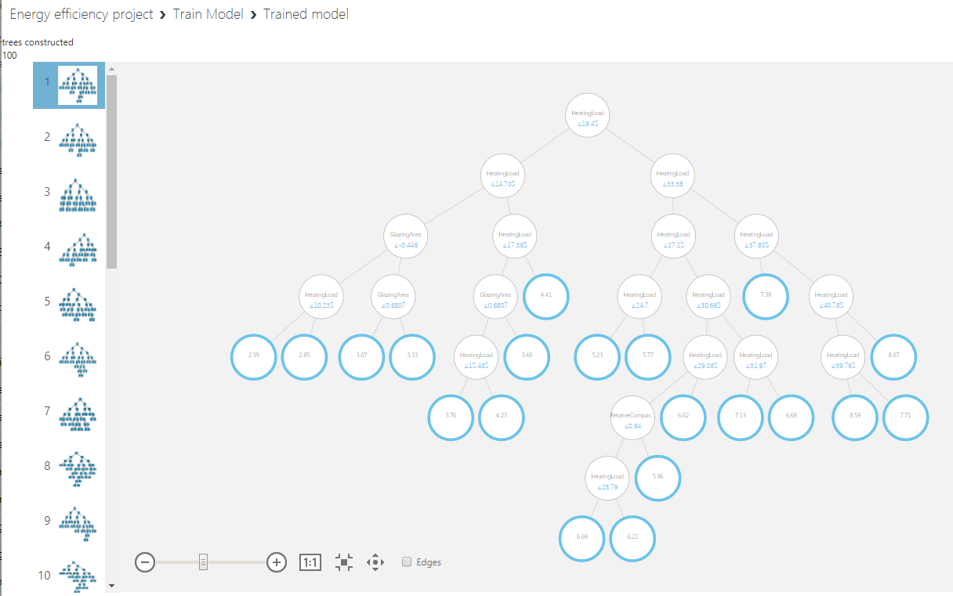

Slide 23
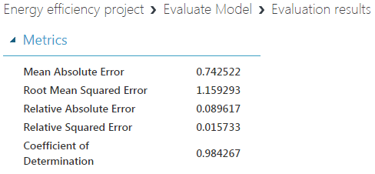
Boosted Decision Tree Regression to predict CoolingLoad response

Slide 24

Thank you for your time!
YouTube URLs:
2 minute (short): https://youtu.be/bIL9AZTkGKU
15 minutes (long): https://youtu.be/2sjkyZTjbrs

